Slide 1
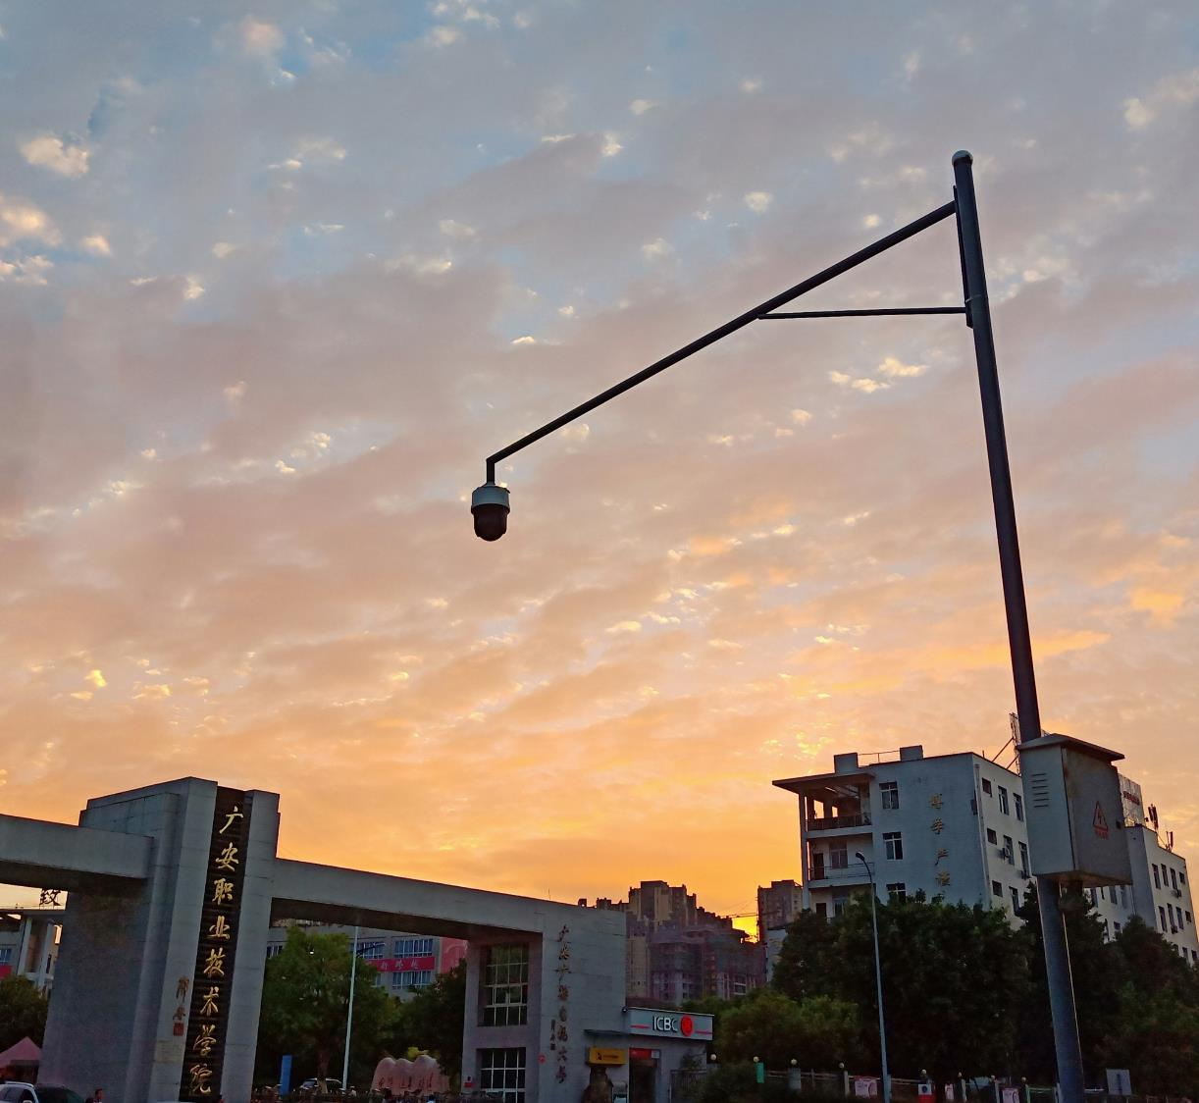
组名：UP
(Unlimited power)
HI, FUTURE!
UP_PISSA(外卖网)
Changed original PPT for Guang ’ an
vocational and technical college production
学校：麓谷校区 汇报人：姜少豪、李佳兴
指导老师：曾老师（曾鹏）

Slide 2
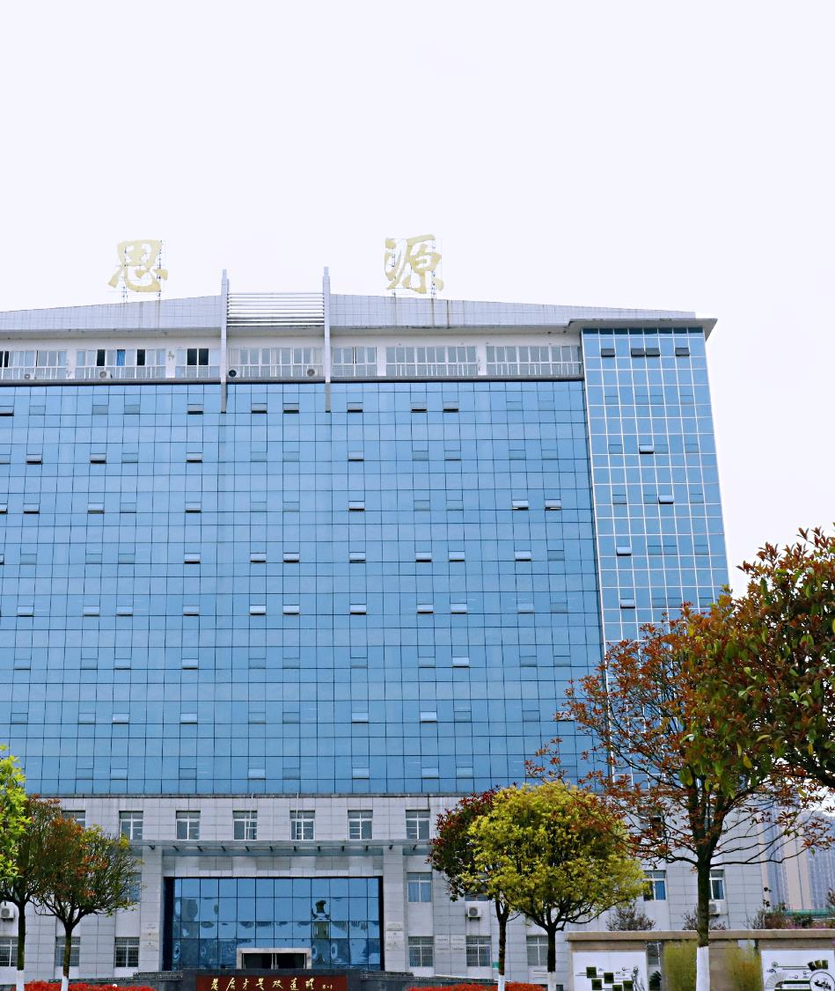

项目初衷：
便利人们的衣食生活。
希望吾组集团尽快上市，十年之内干翻美团！

Slide 3

组长：姜少豪
Contents
01
模板
负责模块：主页、客服、联系我们、
登录与注册、菜单、结账、支付
组员：李佳兴
02
负责模块：购物车、回收站、服务条款
商品详情（TWO）、博客

Slide 4
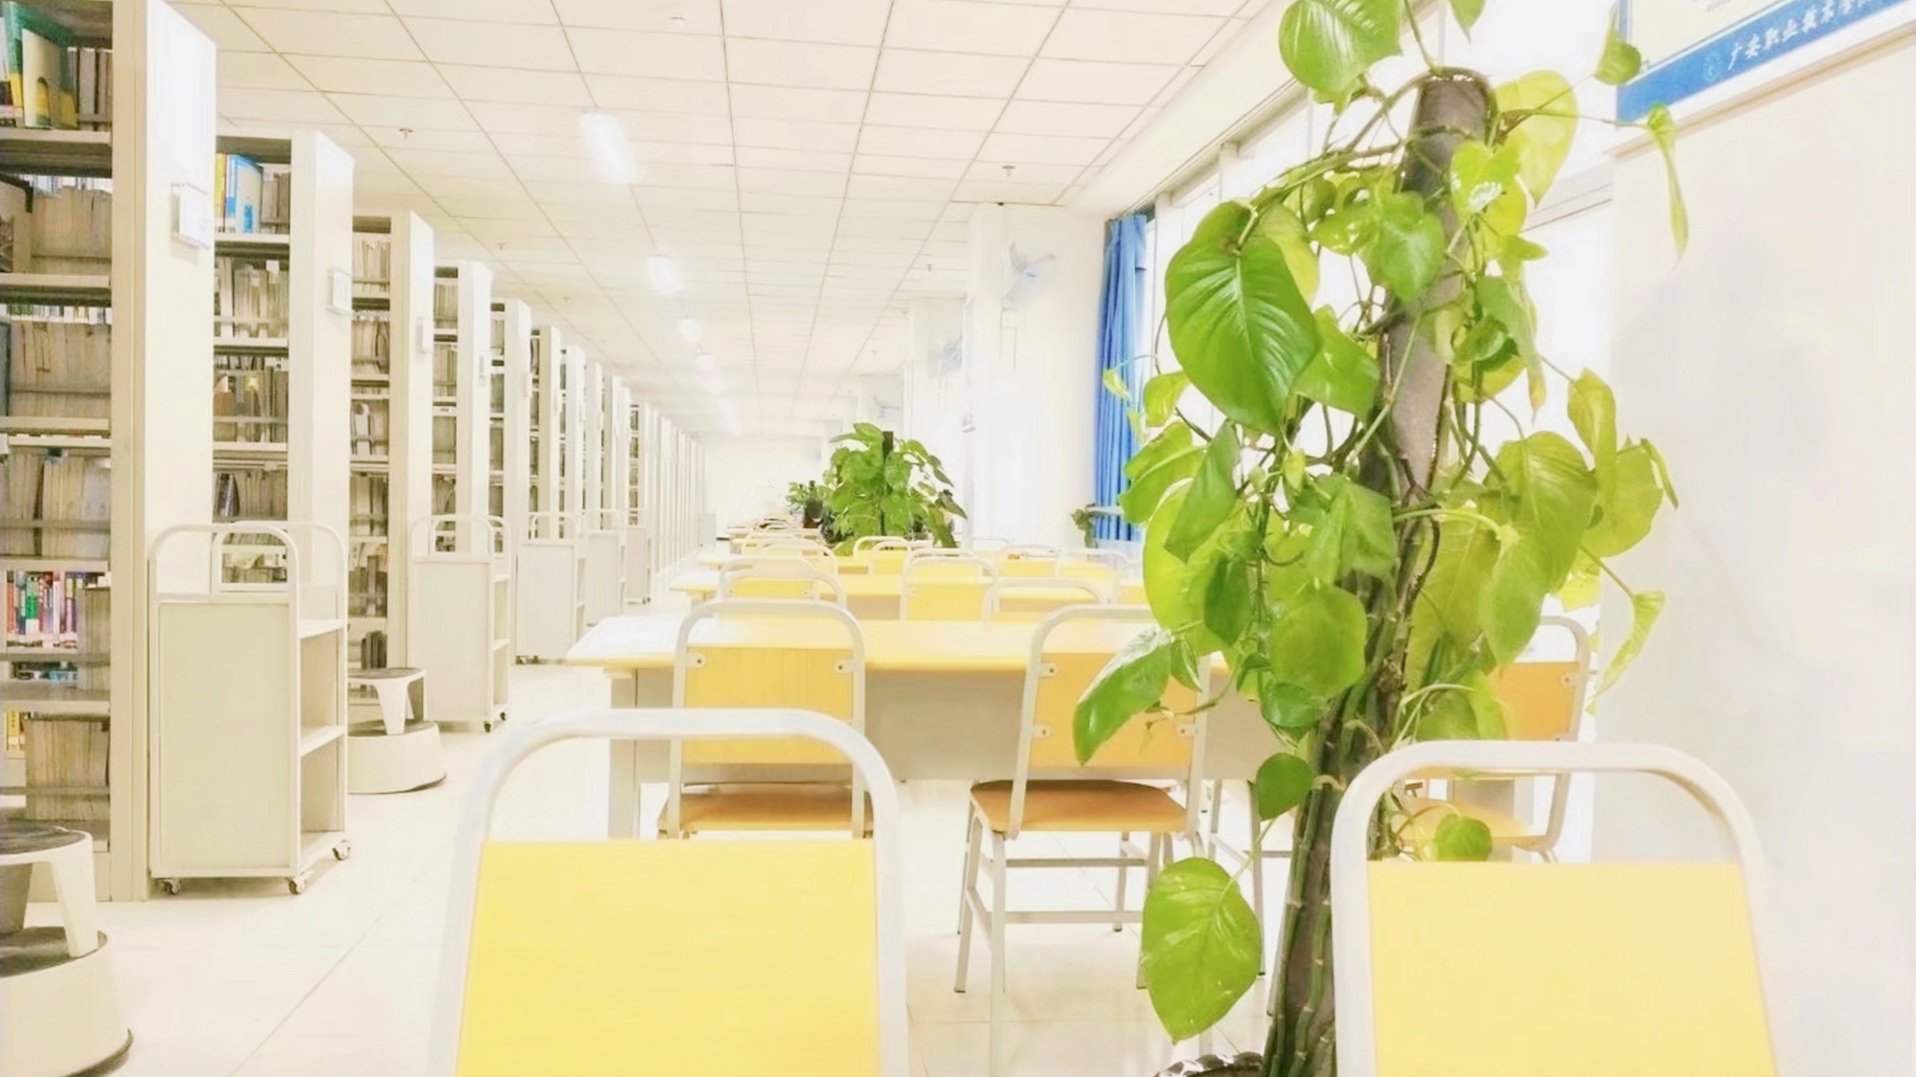
01
项目模板展示
Guang an vocational and technical college.Guang an vocational and technical college .Guang an vocational and technical college

Slide 5
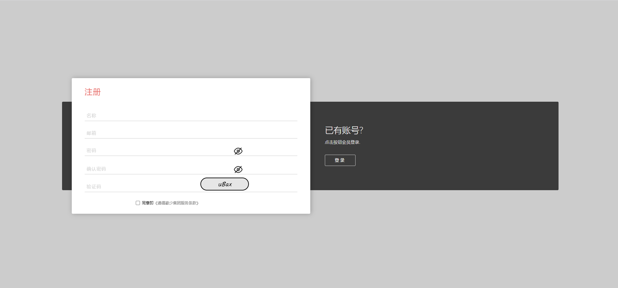
登录与注册

Slide 6

主页

Slide 7
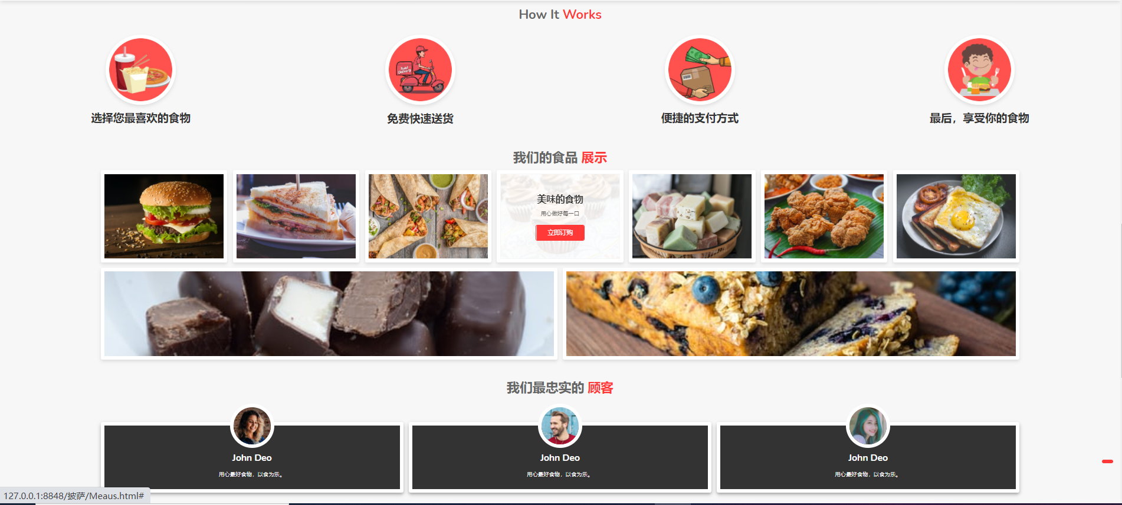
菜单

Slide 8

结账

Slide 9
02
项目展示
Guang an vocational and technical college.Guang an vocational and technical college .Guang an vocational and technical college

Slide 10
03
经验与总结
Guang an vocational and technical college.Guang an vocational and technical college .Guang an vocational and technical college

Slide 11
04
感谢老师点评
Guang an vocational and technical college.Guang an vocational and technical college .Guang an vocational and technical college

Slide 12
感谢聆听！
演讲结束·谢谢大家
Changed original PPT for Guang ’ an
vocational and technical college production
学校：麓谷校区 汇报人：姜少豪、李佳兴

